Slide 1
Presentation on Dataset Electronic Items
Created by
Tanvesha Chavan

Slide 2
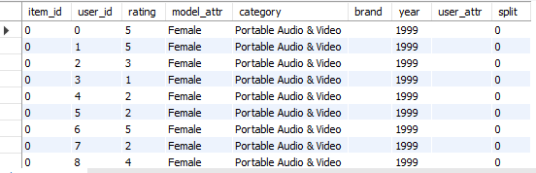
"Retrieve all columns and rows from the electronics table."

Slide 3
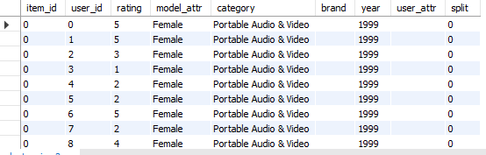
Retrieve all records from the electronics table where the model_attr is set to Female

Slide 4

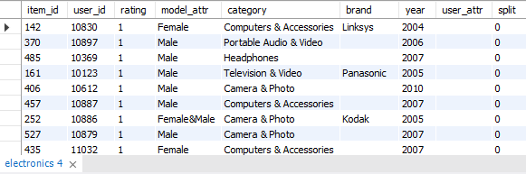
Retrieve all records from the electronics table and sort them by the rating column in ascending order

Slide 5
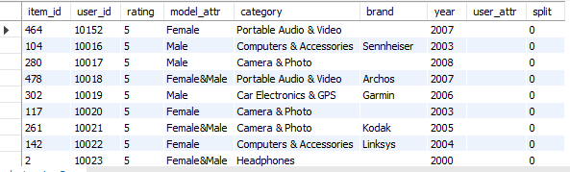
What are all the electronic products sorted by their rating from highest to lowest

Slide 6

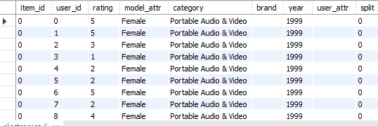
Which electronic products have no brand specified

Slide 7

"Retrieve the unique years from the electronics table by grouping the records based on the year column."

Slide 8
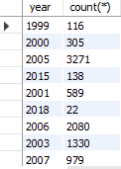
"How many electronic products were released or listed in each year?"

Slide 9

"What are the unique item IDs in the electronics table?"

Slide 10
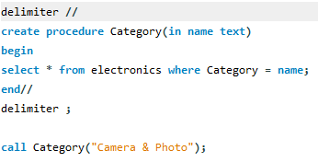
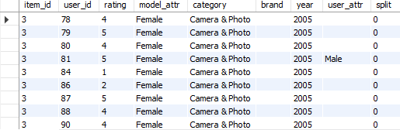
"How can I retrieve all electronic products that belong to the 'Camera & Photo' category using a stored procedure?“

Slide 11
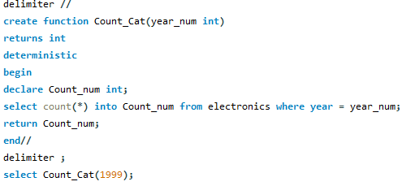

"How can I count the number of electronic products released in a specific year using a function?"

Slide 12
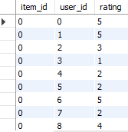
"How can I create a view to display only the item ID, user ID, and rating from the electronics table, and then view its contents?"

Slide 13
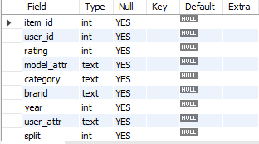
"What is the structure or schema of the electronics table?"

Slide 14
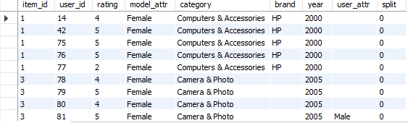
"Retrieve all records from the electronics table where the category column starts with the letter 'C'."

Slide 15
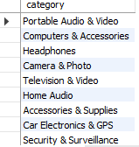
"Retrieve a list of unique categories by grouping the records in the electronics table based on the category column."

Slide 16
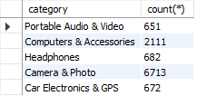
"Which categories in the electronics table have more than 300 products?"

Slide 17
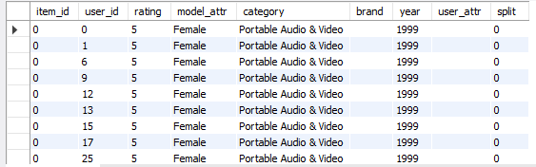
"Which electronic products have the highest rating?"

Slide 18
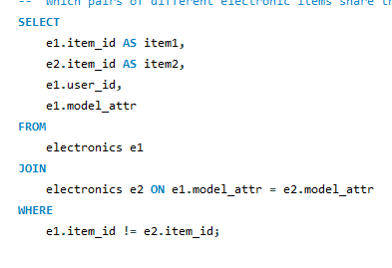
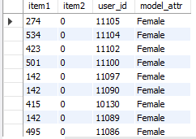
Which pairs of different electronic items share the same model attribute, and who are the users associated with them?"

